Slide 1
Systems Science Methodologies
A broad class of intellectual methods for understanding part-and-whole interactions (Trochim, 2006)
What is System Dynamics Modeling (SDM)?
A computer-aided approach to policy analysis and design characterized by information feedback (i.e., circular causality) (Richardson, 1996)
[mathematically] A set of differential equations representing hypothesized time-dependent inter-dependencies among specified variables
[philosophically] A methodology intended to foster in-depth understanding about the ‘structure’ and ‘behavior’ of complex problems
Social Network Analysis
Micro-simulation Modeling
Agent-based Modeling
System Dynamics Modeling
Notes:
National Cancer Institute funded CISNET project, developed and applied a statistical model of breast cancer in the United States population. That model has contributed to an understanding of the relative contributions of mammographic screening and adjuvant therapy to the decline in breast cancer mortality observed between 1975 and 2000, and has provided background information for the U.S. Preventive Services Task Force’s deliberations on its breast cancer screening guidelines. In this project, my task will be to adapt my existing simulation model of breast cancer to incorporate the effects of the interventions in this project, making it possible to extrapolate from the short-term outcomes observed here to longer term outcomes such as survival, and to provide figures that could underlie cost-effectiveness analysis.
A simulation model may use one or more of the following for more depth on these types of mathematical relationships]. System dynamics differs from other schools of mathematical simulation, such as operations research (Churchman, Ackoff, & Arnoff, 1957) and basic epidemiological modeling (Flanders & Klienbaum, 1995), in that it allows explicit focus on one or more processes of continual change over time. In contrast to most other techniques of mathematical modeling, system dynamics easily incorporates variable relationships that are continuous, non-linear, and lagged.

Slide 2
System Dynamics Modeling (SDM) is Participatory Research
In SDM, group model building engages key stakeholders in all phases of modeling
Patients and caregivers, frontline health workers, payors, and policy-makers, researchers, others
Introduction to group model building: https://en.wikibooks.org/wiki/Scriptapedia
SDM has the potential to:
Promote deep understanding about complex problems
Identify robust policies and implementation strategies
Inform novel research questions, hypotheses, and/or study designs
Build models that build community: Establish task forces, coalitions and other collaborative partnerships
Notes:
In HSR, the potential utility of stakeholder engaged research in all phases of knowledge production and intervention is recognized, but doing so meaningfully is challenging
Meaningful engagement derives from effective collaboration

Slide 3
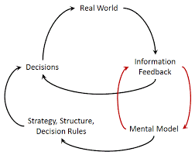

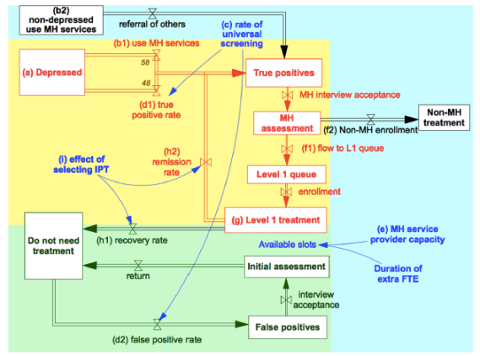
System Dynamics Modeling is Participatory
Stakeholder
engagement
Mental models
made explicit
Model ‘behavior’ evaluated
System ‘structure’
formulated and calibrated
Notes:
First, the phases of modeling. The most important part of the modeling is to participate. This is a grass roots, bottom up, locally specific, approach. In other words, this is a staff driven process, not an edict from on high VA. Second, and this will be the exercise I introduce in just a moment, the modeling helps us all to make explicit to ourselves and to others how we think about the clinic. Please do your best to open up to the possibility that you may even be able to generate new insights about your own thinking as we use the model to learn together.
The third phase of the model building is calibrate. This is what we will do over the next few months to make sure we have the right data and input based on your expertise, the administrative data we have available, and when relevant research literature. Fourth, we will simulate. We will observe how the clinic typically behaves, but also have the opportunity to use the model to test our ideas about what might help the clinic function even more smoothly.
Fifth, we can translate what we learned from model building and testing, to implement an improvement that we all agree is likely to give us the biggest bang for our buck. In this phase, the plan is implemented, the model will be updated with new data throughout the process to help us see how and where the system was impacted by the change. Therefore, we will have a high degree of rigor built in that can help us understand why we are successful or not successful at making ongoing improvements. Last, we can iterate. Since the model remains in place, it can be revisited, reflected on together, and revise as necessary to help sustain the improvement, or to select new improvement strategies in the future.

Slide 4
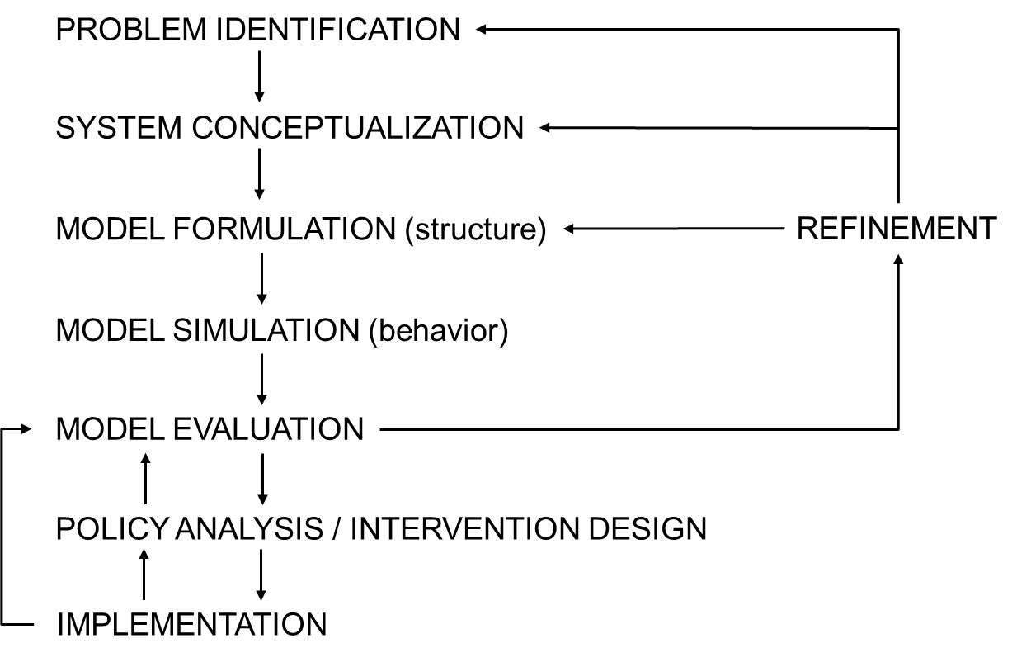
The Iterative Nature of SDM Development and Validation
Adapted from Roberts et al. (1983) and Barlas (1996)
Notes:
What is the problem to be modeled? What data are available?
How to use data? What is the fallibilty of the data?
How should model be structured? What is valid behavior? Key issue: Who is the model for?
Foster confidence in the model’s usefulness and gaining insights about the underlying feedback loop structure
Model formulation
Identify a problem to model (not a system, per se)
Define key ‘reference modes’ to describe the problem, over time
Specify dynamic hypotheses explaining the cause of the problem
Model simulation
Build a computer model of the cause of the problem
Test the model equations, dimensions are correct
Assess the degree to which model reproduces the behavior seen in the real world
Model validation
Are key ‘reference modes’ reproduced (i.e. simulated)?
Recheck that equations are dimensionally correct
Are meaningful, alternative practices or policies that alleviate the problem identified?

Slide 5
The Iterative Nature of SD Model Development and Validation
PROBLEM DEFINITION
Structure validity
SYSTEM CONCEPTUALIZATION
MODEL FORMULATION (structure)
REFINEMENT
MODEL SIMULATION (behavior)
MODEL EVALUATION
Behavioral validity
POLICY ANALYSIS / INTERVENTION DESIGN
IMPLEMENTATION
Adapted from Roberts et al. (1983) and Barlas (1996)
Notes:
What is the problem to be modeled? What data are available?
How to use data? What is the fallibilty of the data?
How should model be structured? What is valid behavior? Key issue: Who is the model for?
Foster confidence in the model’s usefulness and gaining insights about the underlying feedback loop structure
Model formulation
Identify a problem to model (not a system, per se)
Define key ‘reference modes’ to describe the problem, over time
Specify dynamic hypotheses explaining the cause of the problem
Model simulation
Build a computer model of the cause of the problem
Test the model equations, dimensions are correct
Assess the degree to which model reproduces the behavior seen in the real world
Model validation
Are key ‘reference modes’ reproduced (i.e. simulated)?
Recheck that equations are dimensionally correct
Are meaningful, alternative practices or policies that alleviate the problem identified?

Slide 6
Systems Theory: Feedback Concepts from Engineering
Engineers characterize two kinds of feedback loops: ‘reinforcing’ and ‘balancing’
Reinforcing feedback loop: Characteristically tends to amplify a change in any one of its elements over time.
Moving away from equilibrium
Instability
Balancing feedback loop: Adjusts to counteract a change in any one of its elements over time.
Coming to equilibrium
A steady state: Homeostasis

Slide 7
Basic Concepts is SDM: Causal Loop Diagram (CLD)

Slide 8
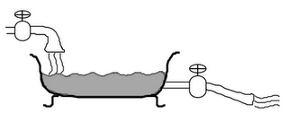
Basic Concepts in SDM: Stocks and Flows
Stock: Accumulation of units, e.g., liters of water in a tub
Flow: Movement of units into, out of, and between stocks
Inflow
Stock
Outflow

Slide 9
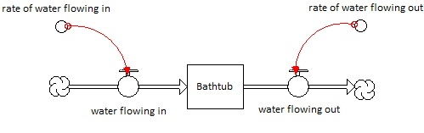
Another Way to Diagram Stocks and Flows
d (Stock)
dt
=
Inflow(t) – Outflow(t)
Link to demo
FLOW: Rate of change (derivative) STOCK: Accumulation over time (integral)
Notes:
How to increase Community participation and decrease community apathy (community non-involvement)

Slide 10
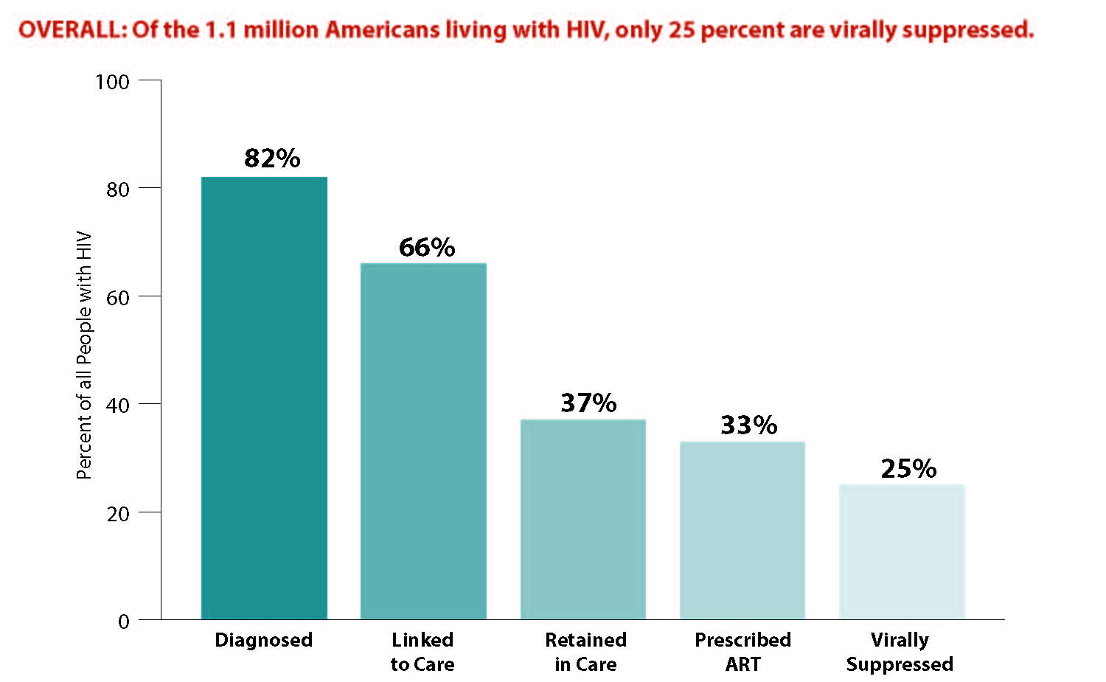
CDC Stages of Care and the “Treatment Cascade” – US Population (July 2012)
A static analysis: Dynamics are implied.

Slide 11
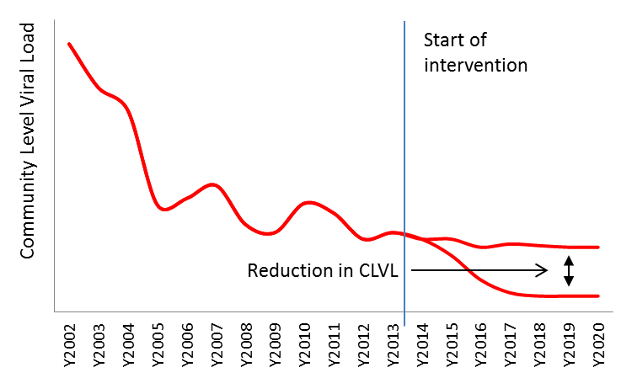
A Hypothetical Reference Mode: Community Level Viral Load (CLVL) Over Time (2002 – 2020)
How did we get here?
How do we get to there?
What’s driving our success?
What’s holding us back?

Slide 12
A Causal Loop Diagram Depicting the Dynamics of Community Viral Load
Notes:
Causal loops are useful because of their ability to show relationships among the elements of a system using features such as loop polarity.
But they fail at quantifying the elements of the system.
If a component increases or decreases for a given time unit (dt), due its causal variable, it is important to know by how much it changed (quantity) and how fast it has changed (at which rate).
Stocks and flows are the concepts that account for such quantities.

